Slide 1
Lecture 4
Signals and Systems (ELL205)
By Dr. Abhishek Dixit
Dept. of Electrical Engineering
IIT Delhi

Slide 2
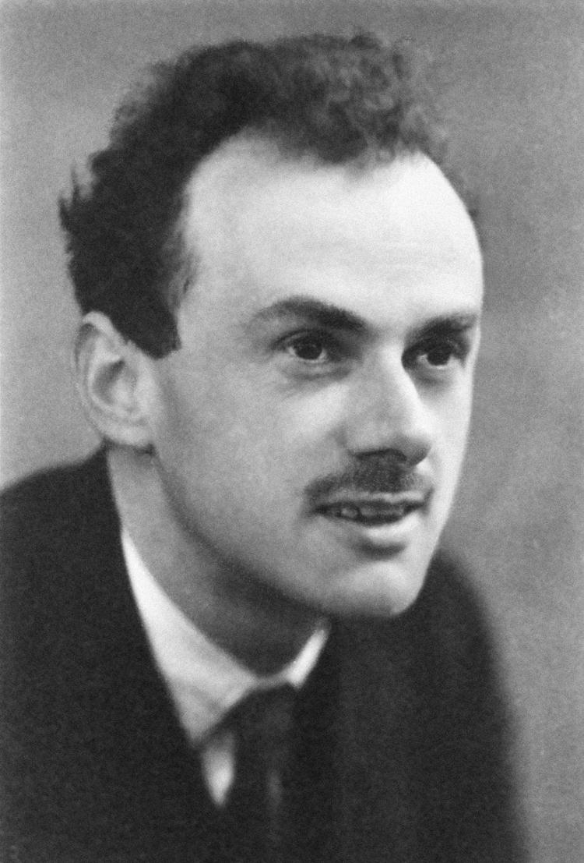
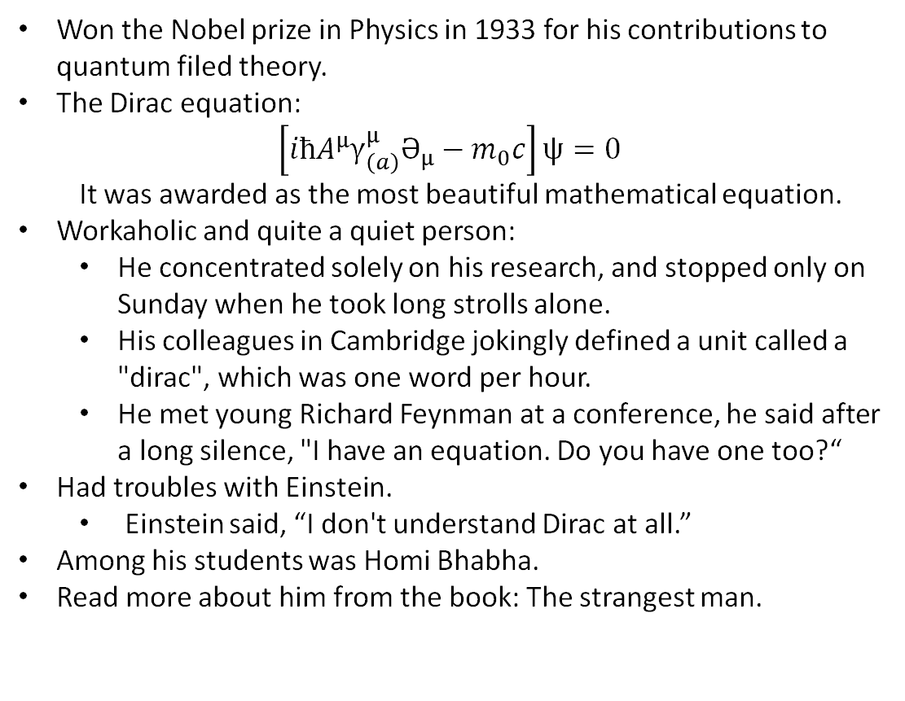
Paul Dirac (1902-1984)
Won the Nobel prize in Physics in 1933 for his contributions to quantum filed theory.
The Dirac equation:
$$\left[iћA^{μ}γ_{\left(a\right)}^{μ}Ә_{μ}−m_{0}c\right]ψ=0$$
  It was awarded as the most beautiful mathematical equation.
Workaholic and quite a quiet person:
  He concentrated solely on his research, and stopped only on Sunday when he took long strolls alone.
  His colleagues in Cambridge jokingly defined a unit called a "dirac", which was one word per hour.
  He met young Richard Feynman at a conference, he said after a long silence, "I have an equation. Do you have one too?“
Had troubles with Einstein.
  Einstein said, “I don't understand Dirac at all.”
Among his students was Homi Bhabha.
Read more about him from the book: The strangest man.

Slide 3
Outline
Signal transformations
Classifications of Signals
Basic Signals
  Exponential
  Unit-step
  Unit-impulse

Slide 4
Outline
Signal transformations
Classifications of Signals
Basic Signals
  Exponential
  Unit-step
  Unit-impulse

Slide 5
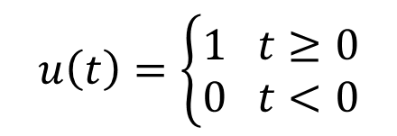
Unit-step
$$u\left(t\right)=\left\{\begin{aligned}1 t≥0 \\ 0 t<0\end{aligned}\right.$$

Slide 6
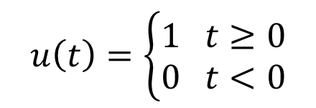

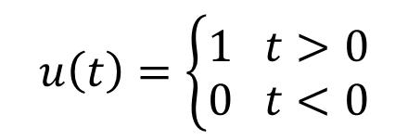



Unit-step
$$u\left(t\right)=\left\{\begin{aligned}1 t≥0 \\ 0 t<0\end{aligned}\right.$$
$$u\left(t\right)=\left\{\begin{aligned}1 t>0 \\ 0 t<0\end{aligned}\right.$$
or
$$1$$
$$t=0$$
$$t$$
At $t=0$, it is not continuous.

Slide 7
Unit-step
$$u\left(t\right)=\left\{\begin{aligned}1 t≥0 \\ 0 t<0\end{aligned}\right.$$
$$u\left(t\right)=\left\{\begin{aligned}1 t>0 \\ 0 t<0\end{aligned}\right.$$
or

Slide 8
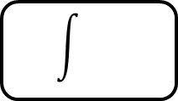
Function equivalence
CT systems are implemented using:
Adders
Integrators

Slide 9
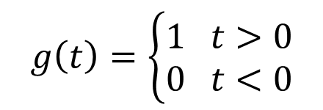

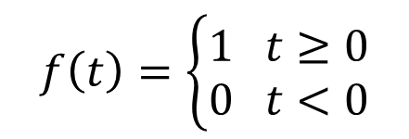
Function equivalence
$$f\left(t\right)=\left\{\begin{aligned}1 t≥0 \\ 0 t<0\end{aligned}\right.$$
$$g\left(t\right)=\left\{\begin{aligned}1 t>0 \\ 0 t<0\end{aligned}\right.$$
$$f\left(t\right)−g(t)$$
Integrator

Slide 10

Function equivalence
$$f\left(t\right)=\left\{\begin{aligned}1 t≥0 \\ 0 t<0\end{aligned}\right.$$
$$g\left(t\right)=\left\{\begin{aligned}1 t>0 \\ 0 t<0\end{aligned}\right.$$
$$f\left(t\right)−g(t)$$
$$0$$
Integrator

Slide 11
Function equivalence
$$f\left(t\right)=\left\{\begin{aligned}1 t≥0 \\ 0 t<0\end{aligned}\right.$$
$$g\left(t\right)=\left\{\begin{aligned}1 t>0 \\ 0 t<0\end{aligned}\right.$$
$$f\left(t\right)−g(t)$$
$$0$$
Integrator
An Integrator sees both $"f(t)"$ and $"g(t)"$ as equivalent.

Slide 12
Function equivalence
Two functions are said to be “equivalent” if they are different only at a countable number of points.

Slide 13


Function equivalence
Two functions are said to be “equivalent” if they are different only at a countable number of points.
$$=$$
$$…$$
$$…$$
all zero signal

Slide 14
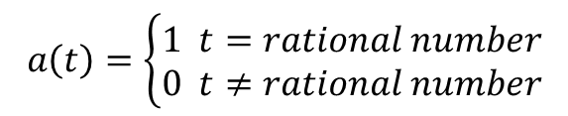
Function equivalence
Two functions are said to be “equivalent” if they are different only at a countable number of points.
Examples of equivalence class 0
$$a\left(t\right)=\left\{\begin{aligned}1 t=rational number \\ 0 t≠rational number\end{aligned}\right.$$
$$…$$
$$…$$
all zero signal

Slide 15
Unit-step
$$u\left(t\right)=\left\{\begin{aligned}1 t≥0 \\ 0 t<0\end{aligned}\right.$$
$$u\left(t\right)=\left\{\begin{aligned}1 t>0 \\ 0 t<0\end{aligned}\right.$$
or
$$1$$
$$t=0$$
$$t$$
At $t=0$, it is not continuous.

Slide 16




Unit-step as a limiting function
$$u\left(t\right)=\lim_{Δ→0}{u_{Δ}(t)}$$
$$u_{Δ}(t)$$
$$1$$
$$0$$
$$Δ$$
$$t$$
At $t=0$ and $t=Δ$, it has slope discontinuity.

Slide 17

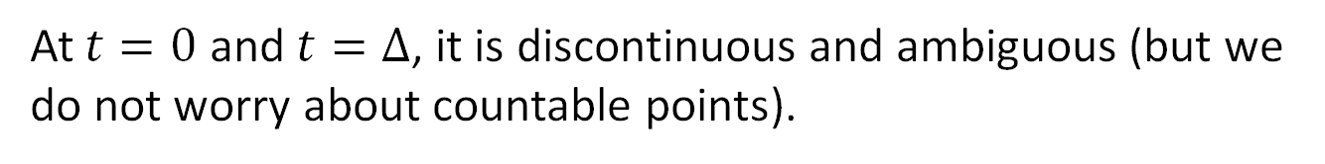
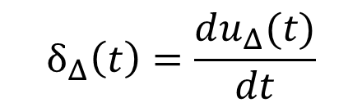
Unit-impulse
$$δ_{Δ}\left(t\right)=\frac{du_{Δ}(t)}{dt}$$
$$\frac{1}{Δ}$$
$$δ_{Δ}\left(t\right)$$
$$0$$
$$t$$
$$Δ$$
At $t=0$ and $t=Δ$, it is discontinuous and ambiguous (but we do not worry about countable points).

Slide 18









Unit-impulse
$$δ\left(t\right)=\lim_{Δ→0}{δ_{Δ}(t)}$$
$$\frac{1}{Δ}$$
$$δ_{Δ}\left(t\right)$$
$$δ\left(t\right)$$
$$0$$
$$t$$
$$0$$
$$t$$
$$Δ$$

Slide 19
Unit-impulse
$$δ\left(t\right)=\lim_{Δ→0}{δ_{Δ}(t)}$$
Known as Dirac delta
$$\frac{1}{Δ}$$
1
$$δ_{Δ}\left(t\right)$$
$$δ\left(t\right)$$
$$0$$
$$t$$
$$0$$
$$t$$
$$Δ$$

Slide 20
Unit-impulse
Von Neumann:
The method of Dirac in no way satisfies mathematical rigor. It is a mathematical ‘fiction’.

Slide 21
Unit-impulse
Von Neumann:
The method of Dirac in no way satisfies mathematical rigor. It is a mathematical ‘fiction’.
Laurent Schwartz:
Do not treat this as a function, treat it as a distribution.

Slide 22
How do we define unit-impulse ?

Slide 23
How do we define unit-impulse ?
How do we define any function $f(t)$ ?

Slide 24
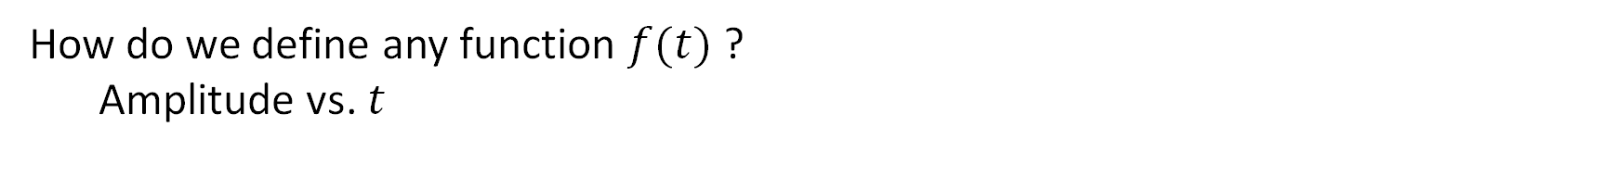
How do we define unit-impulse ?
How do we define any function $f(t)$ ?
  Amplitude vs. $t$

Slide 25
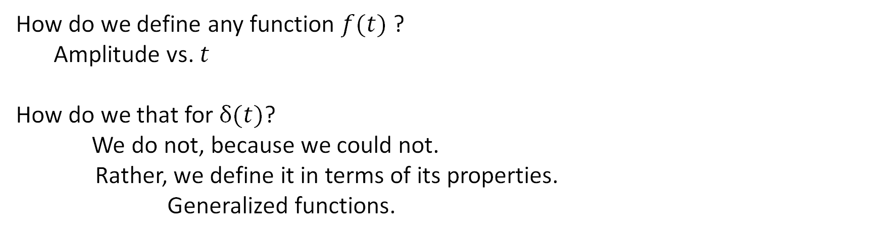
How do we define unit-impulse ?
How do we define any function $f(t)$ ?
  Amplitude vs. $t$
How do we that for $δ(t)$?
We do not, because we could not.
Rather, we define it in terms of its properties.
Generalized functions.

Slide 26
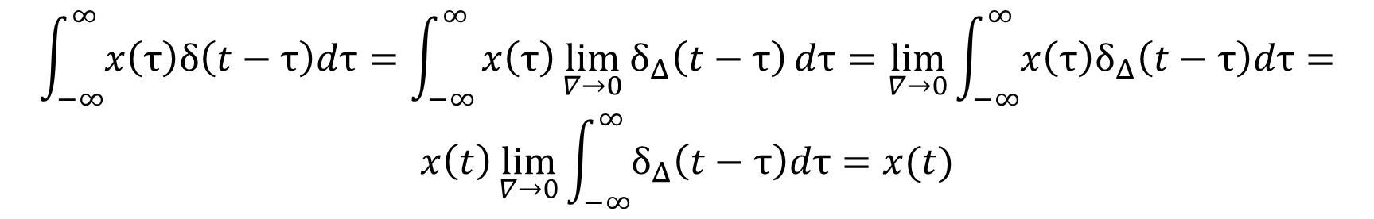
How do we define unit-impulse ?
$$\int_{−∞}^{∞}{x\left(τ\right)δ\left(t−τ\right)dτ}=\int_{−∞}^{∞}{x\left(τ\right)\lim_{∇→0}{δ_{Δ}\left(t−τ\right)}dτ}=\lim_{∇→0}{\int_{−∞}^{∞}{x\left(τ\right)δ_{Δ}\left(t−τ\right)dτ}}=$$
$$x\left(t\right)\lim_{∇→0}{\int_{−∞}^{∞}{δ_{Δ}\left(t−τ\right)dτ}}=x(t)$$

Slide 27
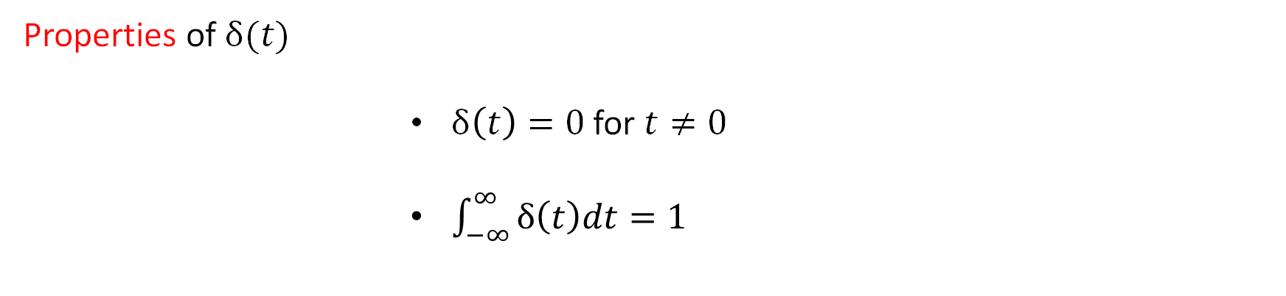
How do we define unit-impulse ?
Properties of $δ(t)$
              $δ\left(t\right)=0$ for $t≠0$
              $\int_{−∞}^{∞}{δ\left(t\right)dt=1}$
$$δ\left(t\right)$$
1
$$0$$
$$t$$

Slide 28



Unit-impulse
$$δ\left(t\right)=\lim_{Δ→0}{δ_{Δ}(t)}$$
$$\frac{1}{Δ}$$
$$δ_{Δ}\left(t\right)$$
$$0$$
$$t$$
$$Δ$$

Slide 29
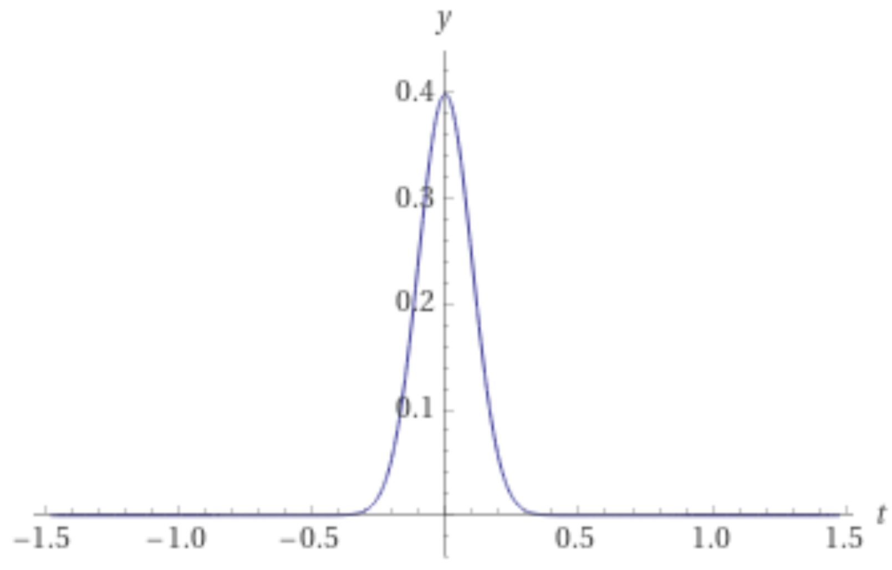










Unit-impulse
$$δ\left(t\right)=\lim_{Δ→0}{δ_{Δ}(t)}$$
$$\frac{1}{Δ}$$
$$\frac{1}{2Δ}$$
$$\frac{1}{Δ}$$
$$δ_{Δ}\left(t\right)$$
$$δ_{Δ}\left(t\right)$$
$$δ_{Δ}\left(t\right)$$
$$0$$
$$t$$
$$−Δ$$
$$t$$
$$−Δ$$
$$t$$
$$Δ$$
$$Δ$$
$$Δ$$
$$\frac{1}{Δ}$$
$$δ_{Δ}\left(t\right)$$
$$δ_{Δ}\left(t\right)$$
$$0$$
$$t$$
$$−Δ$$
$$Δ$$
$$t$$

Slide 30

Unit-impulse
Evaluate $\int_{−∞}^{t}{δ\left(τ\right)dτ}=f(t)$

Slide 31





Unit-impulse
Evaluate $\int_{−∞}^{t}{δ\left(τ\right)dτ}=f(t)$
running integration
$$δ\left(τ=0\right)$$
1
$f\left(t\right)=1$ $t>0$
$$0$$
$$t$$
$$τ$$

Slide 32


Unit-impulse
Evaluate $\int_{−∞}^{t}{δ\left(τ\right)dτ}=f(t)$
running integration
$$δ\left(τ=0\right)$$
$f\left(t\right)=1$ $t>0$
1
$f\left(t\right)=0$ $t<0$
$$t$$
$$0$$
$$τ$$

Slide 33
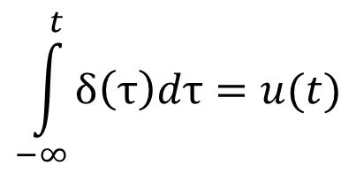
Unit-impulse
$$\int_{−∞}^{t}{δ\left(τ\right)dτ}=u(t)$$

Slide 34
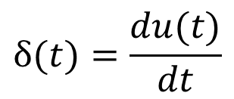
Unit-impulse
$$\int_{−∞}^{t}{δ\left(τ\right)dτ}=u(t)$$
$$δ(t)=\frac{du(t)}{dt}$$
Heaviside definition

Slide 35
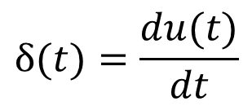
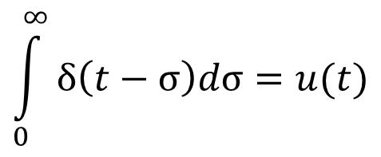
Unit-impulse
$$\int_{−∞}^{t}{δ\left(τ\right)dτ}=u(t)$$
$$δ(t)=\frac{du(t)}{dt}$$
Heaviside definition
$$\int_{0}^{∞}{δ\left(t−σ\right)dσ}=u(t)$$

Slide 36
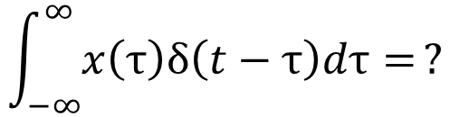

Unit-impulse
$$x\left(t\right)δ\left(t\right)=?$$
$$\int_{−∞}^{∞}{x\left(τ\right)δ\left(t−τ\right)dτ=}?$$

Slide 37

Unit-impulse
$$x\left(t\right)δ\left(t\right)=x(0)δ(t)$$
$$\int_{−∞}^{∞}{x\left(τ\right)δ\left(t−τ\right)dτ=}\int_{−∞}^{∞}{x\left(t\right)δ\left(t−τ\right)dτ=x\left(t\right)\int_{−∞}^{∞}{δ\left(t−τ\right)dτ}=x(t)}$$

Slide 38
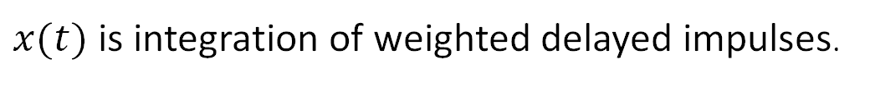
Unit-impulse
$$x\left(t\right)δ\left(t\right)=x(0)δ(t)$$
$$\int_{−∞}^{∞}{x\left(τ\right)δ\left(t−τ\right)dτ=}\int_{−∞}^{∞}{x\left(t\right)δ\left(t−τ\right)dτ=x\left(t\right)\int_{−∞}^{∞}{δ\left(t−τ\right)dτ}=x(t)}$$
$x(t)$ is integration of weighted delayed impulses.

Slide 39
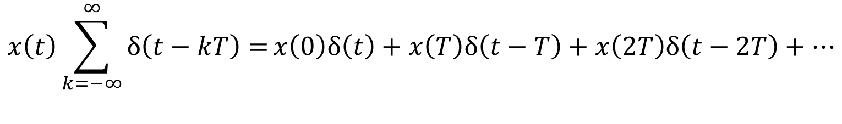
Unit-impulse
$$x\left(t\right)\sum_{k=−∞}^{∞}{δ\left(t−kT\right)=}x\left(0\right)δ\left(t\right)+x\left(T\right)δ\left(t−T\right)+x\left(2T\right)δ\left(t−2T\right)+…$$

